Slide 1

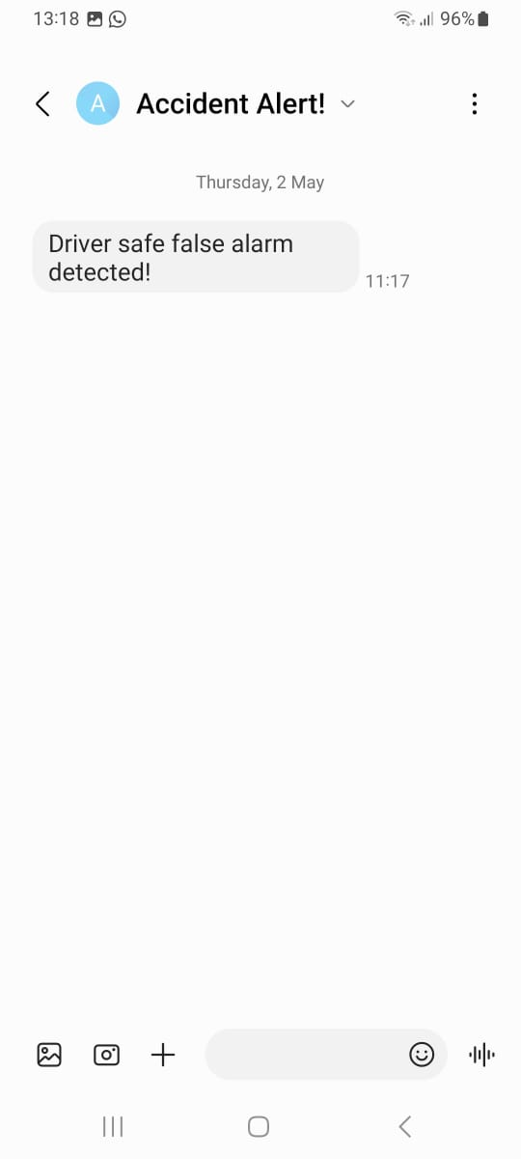
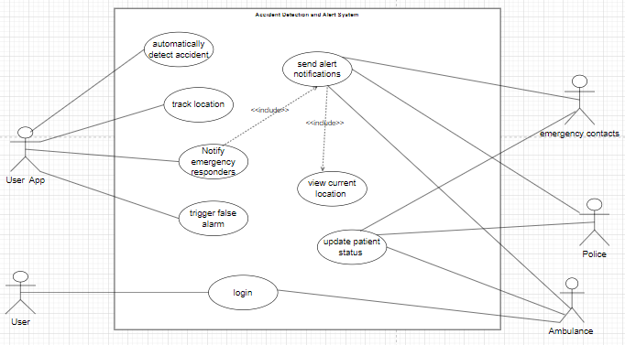
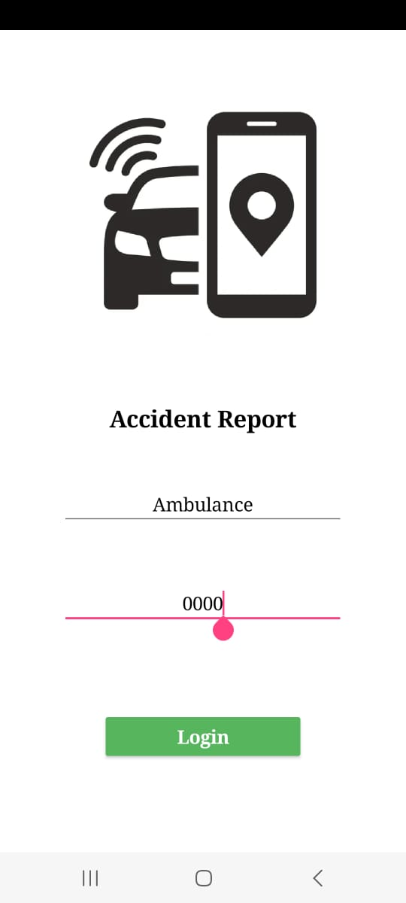
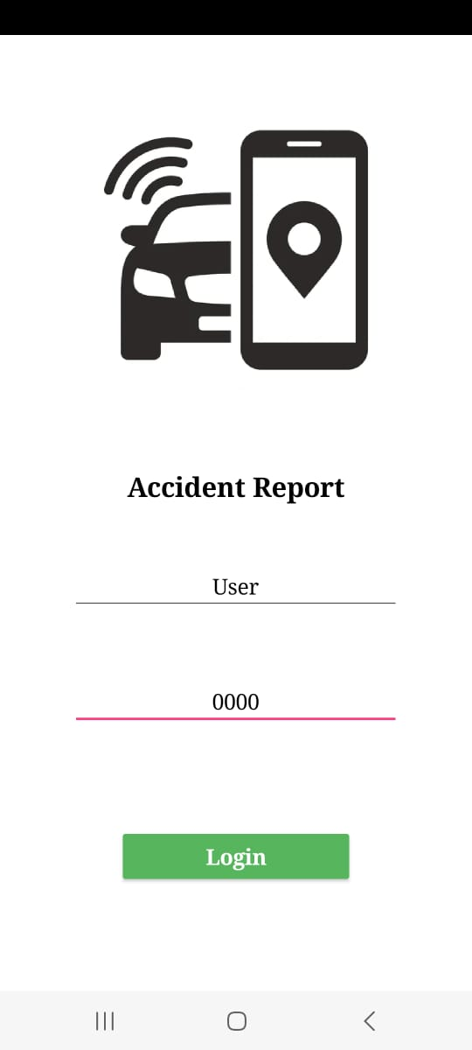
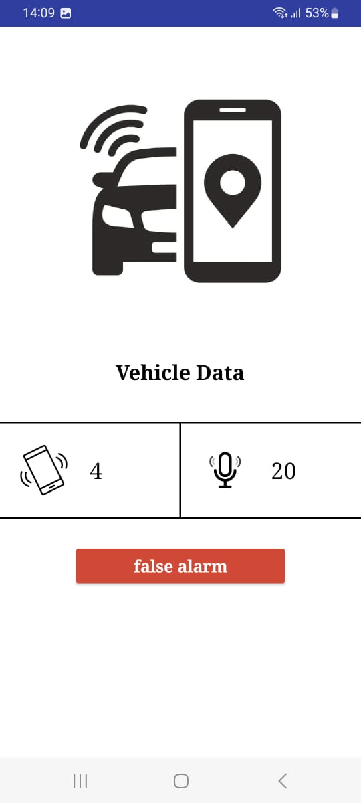
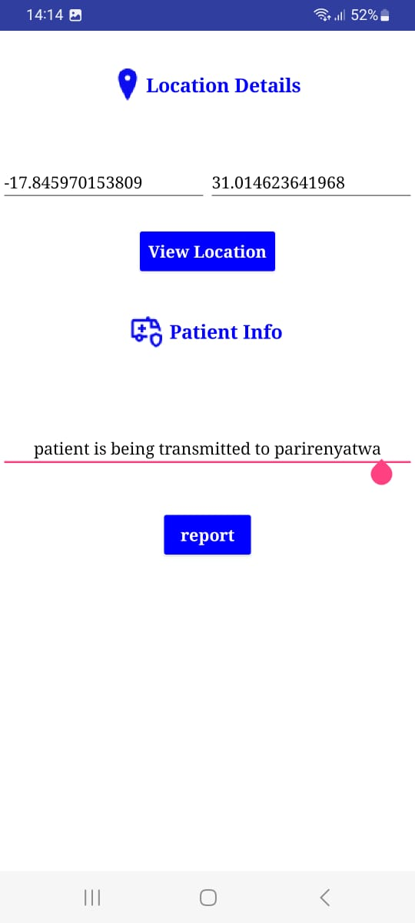
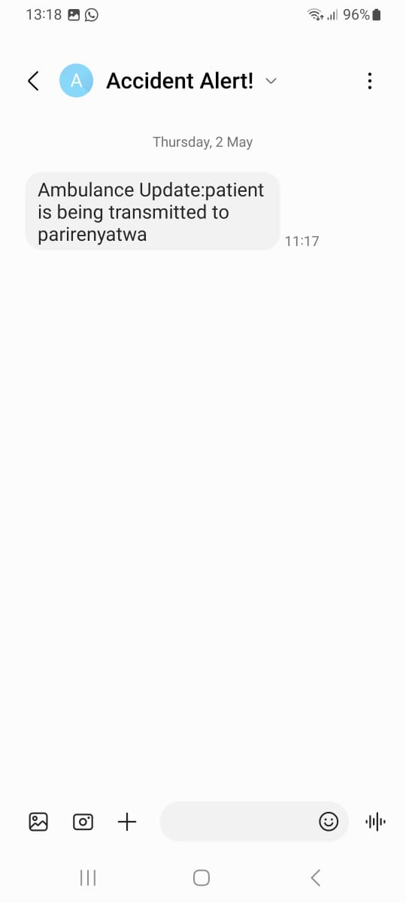
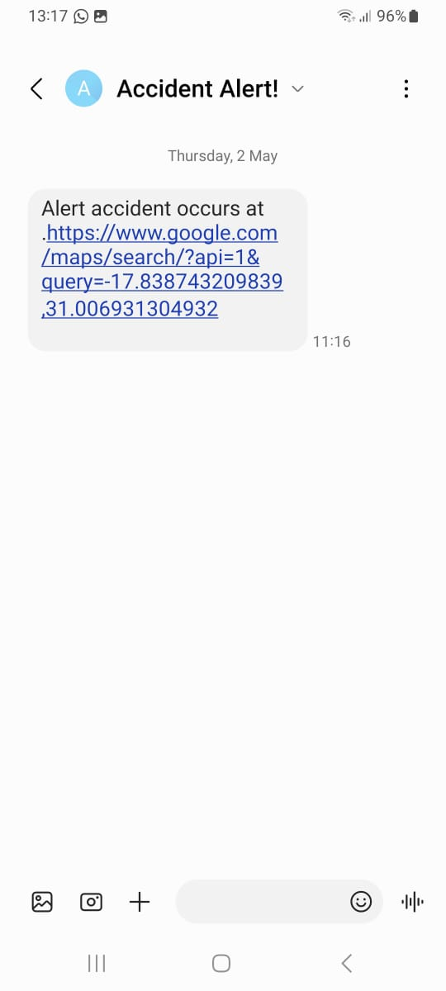
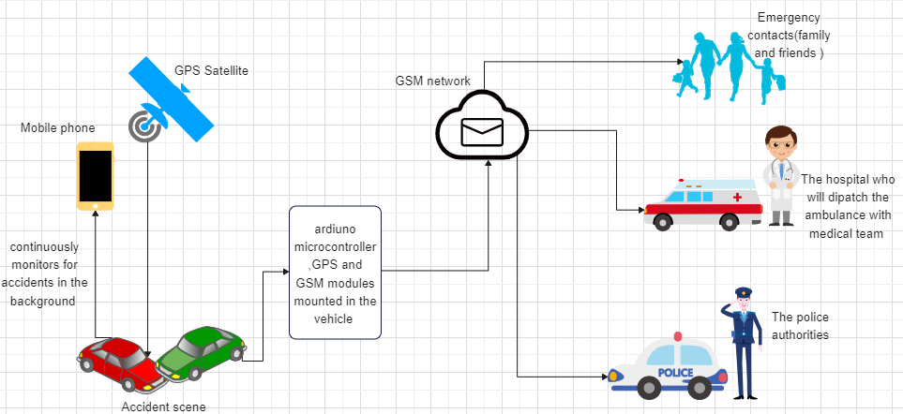
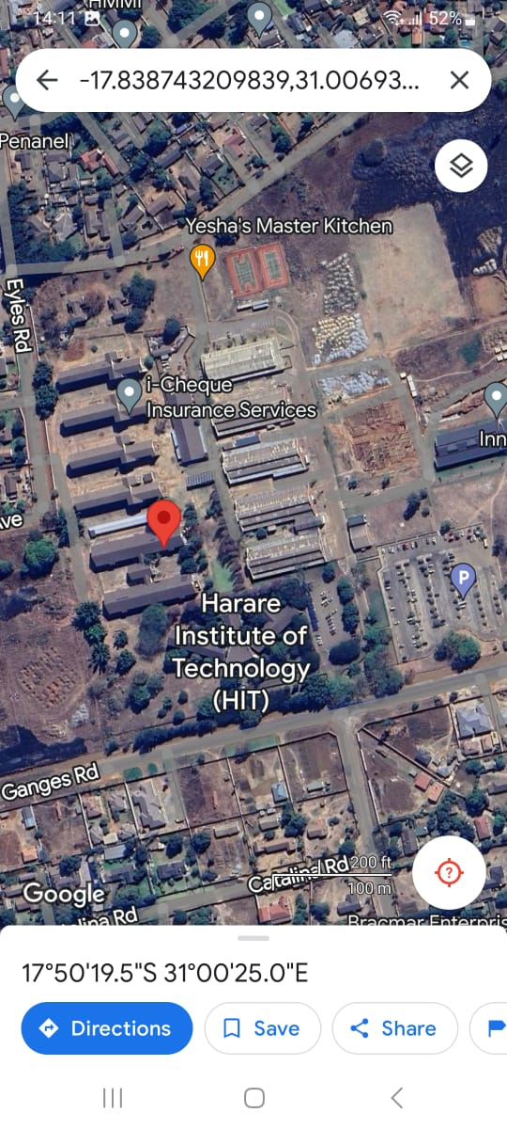
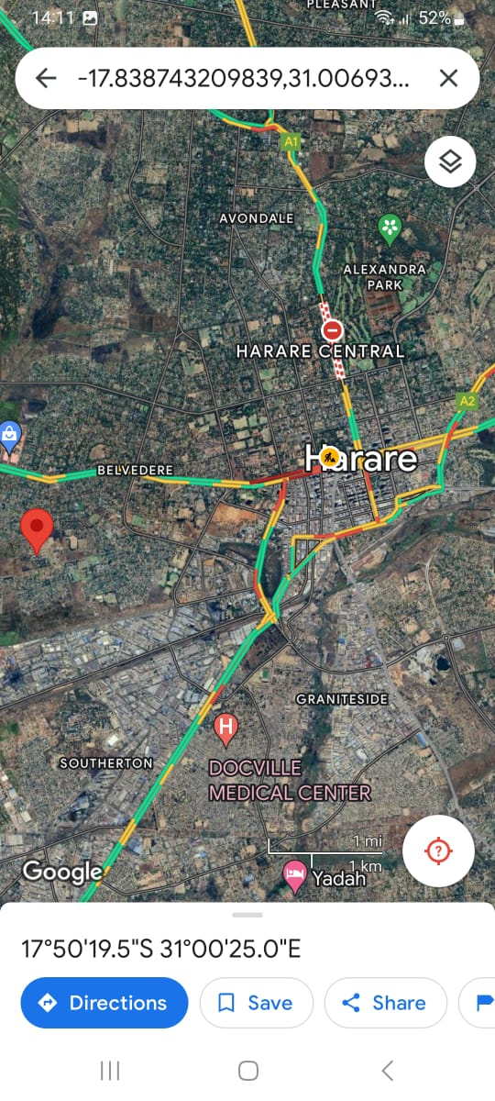
ACCIDENT DETECTION AND ALERT SYSTEM
MELISSA ANESU GOTOSA - Software Engineering Department
1.0 Abstract
3.0. Problem definition
7.0. Use Case Diagram
Lifelong personal mobility has greatly increased the potential for transportation-related accidents and the subsequent loss of life or severe damage to contemporary life. Anyone is prone to accidents. This paper proposes a way to help reduce the accident rate in the country. The system introduced is an Accident
Detection and Alert system. The Android Accident Detection ad Alert System aims to utilize sensors, such as a GPS module, a GSM module, gyroscope or accelerometer and alarm trigger system to detect accidents and promptly notify nearby rescue teams and hospital facilities. By leveraging the capabilities of these sensors, they will sense the accident and raise alarm. The system can accurately detect accidents and send instant alerts to the appropriate authorities, enabling them to take immediate actions. Emergency responders can also send updates upon action has been taken.
In most cases when a road accident takes place, the rescue team or the police authorities are not informed in time.
Furthermore, the delay caused by the rescue team in reaching the accident site and the heavy traffic congestion in between the accident location and the hospital facilities increases the risk of death for the victim.
Therefore there is a need for a reliable and efficient system that can detect accidents in real-time and notify the relevant authorities promptly.
4.0. Overview of the developed system
The Android Accident Detection ad Alert System aims to utilize sensors, such as a GPS module, a GSM module, gyroscope or accelerometer and alarm trigger system to detect accidents and promptly notify nearby rescue teams and hospital facilities. By leveraging the capabilities of these sensors, they will sense the accident and raise alarm. The system can accurately detect accidents and send instant alerts to the appropriate authorities, enabling them to take immediate actions. Emergency responders can also send updates upon action has been taken.
8.0. Screenshots
5.0. Objectives
To automatically detect abnormal sound reading and sensor reading, whilst user app continuously senses for accidents in the background.
To track the location coordinates of the area where accident took place to help determine fastest route to point of collision.
To send alert notifications to hospitals, police authorities and emergency contacts.
To keep updating status of patient to keep emergency contacts and police prepared and well informed.
To manually deactivate the emergency alert in case of a false alarm
2.0. Introduction
Conclusion
The proposed accident detection and alert system aims to revolutionize the way accidents are identified and emergency responses are triggered. This system is designed to provide real-time monitoring and immediate notifications in the event of an accident, ensuring swift assistance and potentially saving lives.
The Android Accident Detection ad Alert System aims to utilize sensors, such as a GPS module, a GSM module, gyroscope or accelerometer and alarm trigger system to detect accidents and promptly notify nearby rescue teams and hospital facilities. By leveraging the capabilities of these sensors, they will sense the accident and raise alarm. The system can accurately detect accidents and send instant alerts to the appropriate authorities, enabling them to take immediate actions. Emergency responders can also send updates upon action has been taken.
In conclusion, the accident detection system is designed with several key objectives in mind, aiming to enhance road safety, minimize rescue time for accident victims, and facilitate efficient coordination with emergency services. By automatically detecting abnormal sound and sensor readings, continuously monitoring for accidents in the background, and tracking precise location coordinates of accidents, the system provides timely alerts to hospitals, police authorities, and emergency contacts.
Furthermore, the system offers real-time status updates on accident victims, ensuring that emergency responders and contacts remain well-informed and prepared to provide assistance. To optimize its effectiveness, the system utilizes advanced algorithms for anomaly detection, integrates multi-channel alert notifications, and prioritizes user feedback for iterative improvement.
Overall, the accident detection system represents a proactive approach to road safety, leveraging technology to mitigate the impact of accidents and potentially save lives by facilitating swift and coordinated emergency response efforts.
6.0. System Overview
Supervisor –W. Makondo

